Slide 1
TextSpot AI
Orientador: Sérgio Aleixo
Alexandre Gazur - 102751
Daniel Ferreira - 102885
João Matos – 103182
Ricardo Pinto - 103078

Slide 2
Goals
Allow users to detect synthetic text through a browser extension;
Calculate metrics (ex. perplexity) for identifying synthetic text;
Allow the use of different models and metrics for synthetic text detection and be easily extensible, allowing you to add new models or metrics;
Work on content in web pages and PDF files;
Highlight the excerpts according to the “probability” of corresponding to synthetic text, allowing the user to define the level from which the highlighting is applied.

Slide 3
01
State of the art

Slide 4


Related Work
Originality.AI
GPTZero
OpenAI (TODO)
Dap
Plagiarism Checker and AI Detector
Plagiarism Scores
Highlighted Portions
File Batch Uploads
Despite being red, Mars is a cold place. It’s full of iron oxide dust

Slide 5
02
Actors & Use Cases

Slide 6

Actors
Regular User
Admin
LM Developer
Journalists, Researchers, Social Media Users, Teachers, Students, etc.
Initial our team of 4.
Have maximum/all permissions.
Anyone with a LM can easily add their own language models and metrics to be used by our AI.

Slide 7
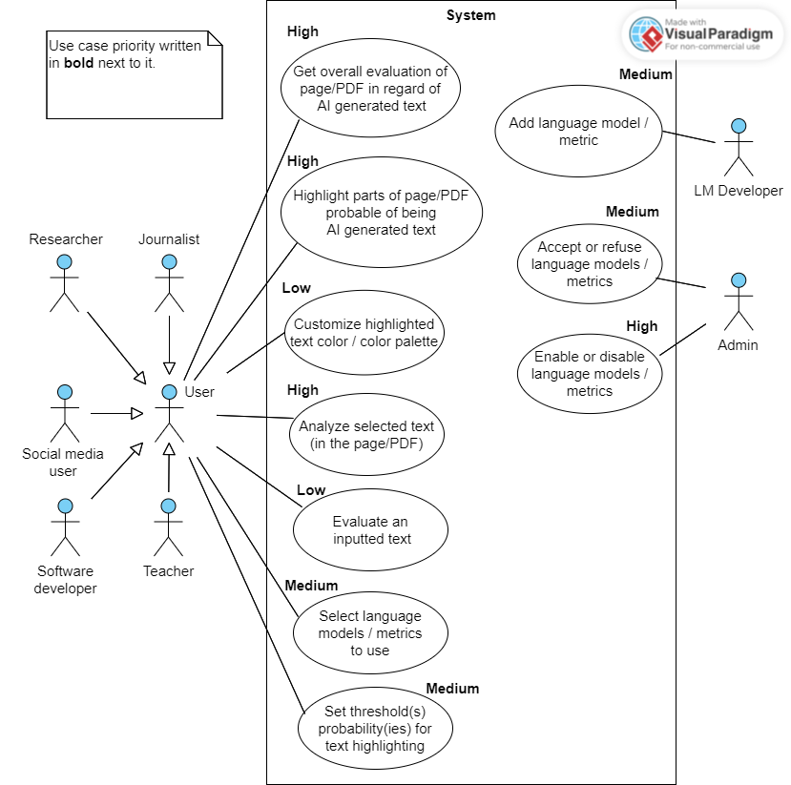
Use cases

Slide 8
03
Requirements

Slide 9
Functional Requirements
The extension must be downloadable via the web and work in at least 1 browser;
Must be able to display the overall analysis of the current web page or PDF file;
Must be able to highlight parts of the current web page or PDF file that it deems is probably AI generated text;
Must be customizable by the user through an intuitive UI:
Turn on/off;
Set threshold(s) probability(ies) for text highlighting;
Select which language models and metrics to use;

Slide 10
Functional Requirements (continuation)
Flexible architecture;
Flexible AI;
Must have a text input to evaluate whichever text the user wants/inputs;
UI must allow the user to customize the colors of underlined/highlighted text.

Slide 11
Non Functional Requirements
TODO;

Slide 12
Architecture
TODO;

Slide 13
Mockup
TODO ( Daniel);

Slide 14
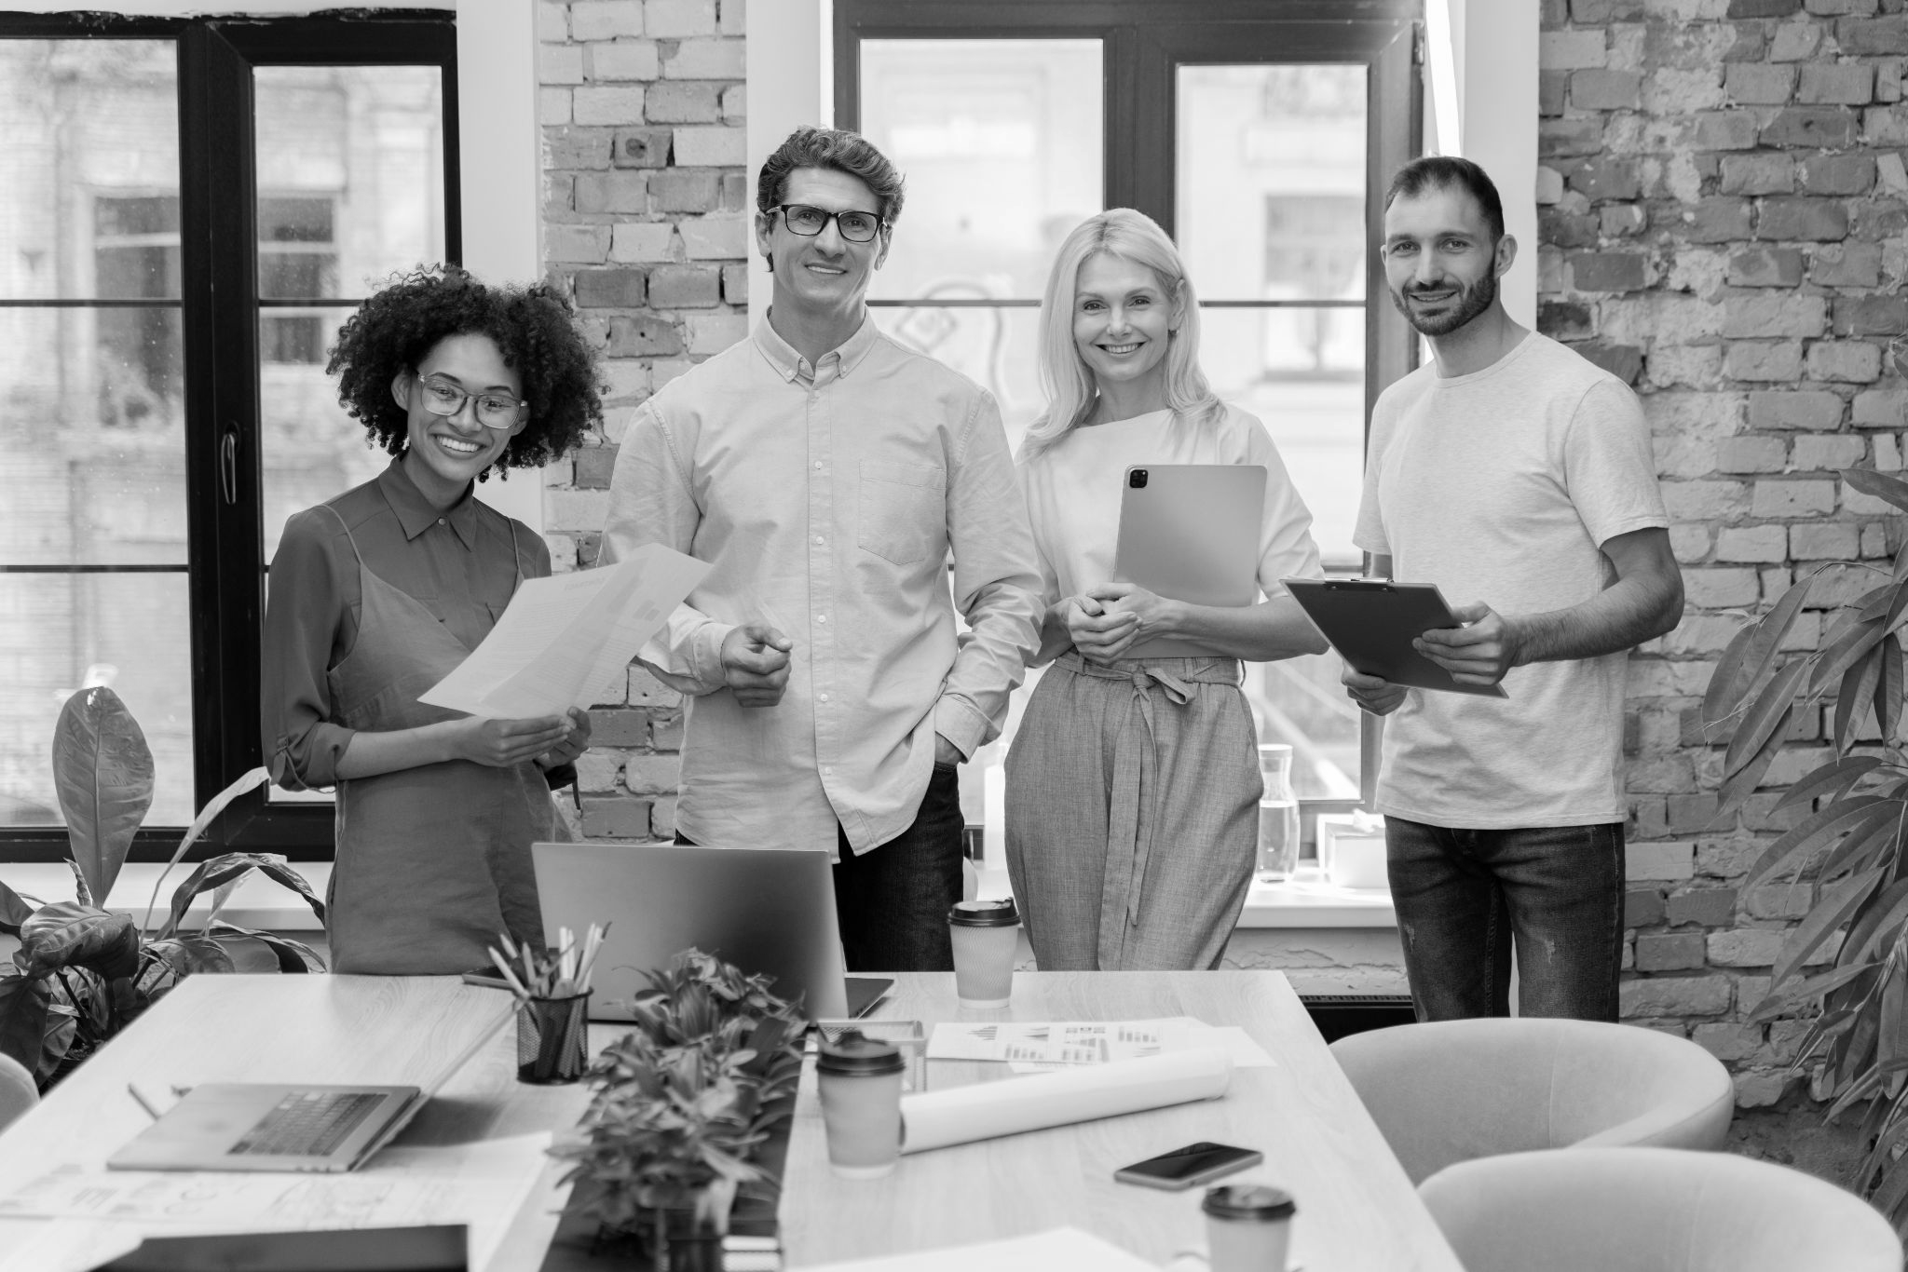
Our team
Martha Reid
Phil Coulson
Sharon Kent
You can speak a bit about this person here
You can speak a bit about this person here
You can speak a bit about this person here

